Slide 1
Lecture 4 Linear Programming II

Slide 2
Warm up
First formulate assuming that all the demand has to be met at each city. Bonus: How do I incorporate the penalty in the objective? (Hint: introduce a set of new decision variables that keep track of how much is shipped to each city)

Slide 3
Agenda
Graphical LP solution
“Special cases” of LP solutions
Infeasible
Multiple optimal solutions
Unbounded
LP formulation guidelines
Formulation examples
Work scheduling
Blending II
RV problem (product mix)

Slide 4
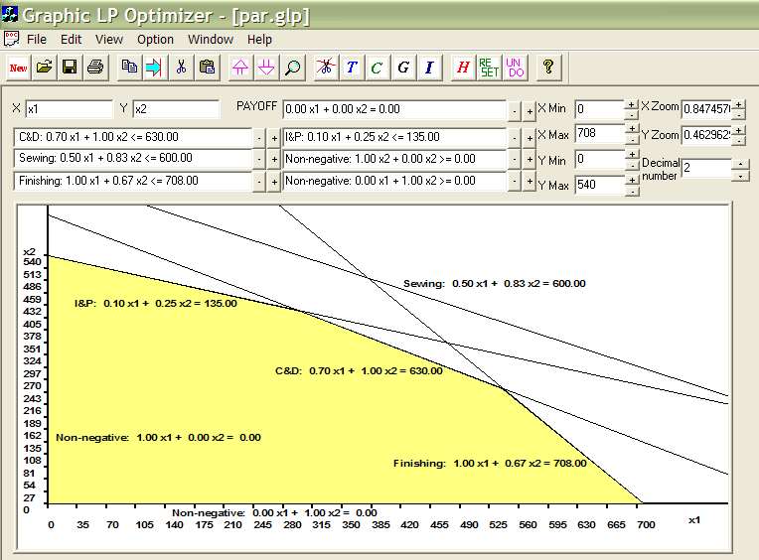
Graphical Solution-Feasible Region
Par Problem
Objective Maximize 10 x₁ + 9 x₂
Subject to:
Cutting & Dyeing: 7/10 x₁ + x₂ ≤ 630
Sewing: 1/2 x₁ + 5/6 x₂ ≤ 600
Finishing: x₁ + 2/3 x₂ ≤ 708
Inspection & Packaging: 1/10 x₁+ 1/4 x₂ ≤ 135
Non-negative: x₁ ≥ 0 , x₂ ≥ 0
Plot the feasible region

Slide 5
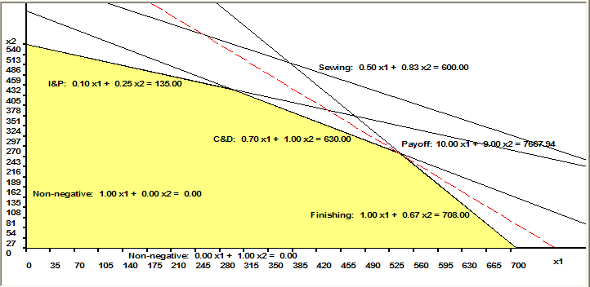
Graphical Solution-Objective Function
Objective Maximize 10 x₁ + 9 x₂
Iso-profit lines
3D view of the profit function
Optimal solution (x₁, x₂) should be one of the corner
points of the feasible region.

Slide 6
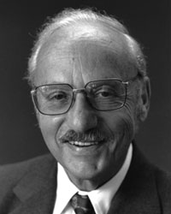
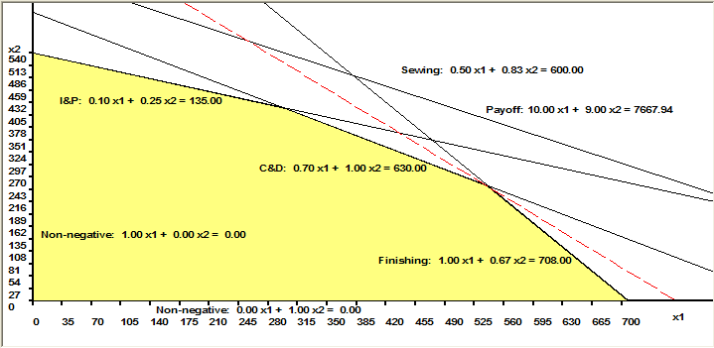
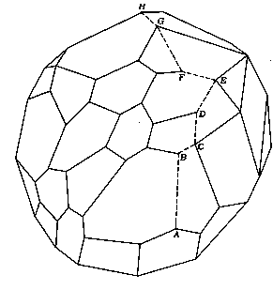
Graphical Solution – Cont’d
Binding constraints: C&D, Finishing
Slack constraint: I&P
Redundant constraint: Sewing
Note: Simplex Method (by George Dantzig, 1947)
1. Start with a feasible corner point solution
2. Check to see if a feasible neighboring corner
point is better
3. If not, stop; otherwise move to that better neighbor
and return to step 2.
Starting at A, the simplex method
proceeds from vertex to vertex until
it reaches an optimal value at H.

Slide 7
Product Mix Example
Par, Inc. Problem
Par, Inc. manufactures two types of golf bags: standard and deluxe. The profit contribution of a standard golf bag is $10. The profit contribution of a deluxe golf bag is $9. The production of golf bags mainly consists of four steps: cutting & dyeing, sewing, finishing, inspection & packaging. Each standard golf bag requires 7/10 hours of cutting& dyeing, 1/2 hour of sewing, 1 hour of finishing, and 0.1 hour of inspection & packaging. Each deluxe golf bag requires 1 hours of cutting & dyeing, 5/6 hour of sewing, 2/3 hour of finishing, and 1/4 hour of inspection & packaging. Demand for golf bags is unlimited. However, due to the capacity and labor constraints, each week Par has at most 630 hours of cutting & dyeing, 600 hours of sewing, 708 hours of finishing, and 135 hours of inspection and packaging for the production of golf bags. Par wishes to maximize weekly profit. Formulate a mathematical model of Par's situation that can be used to maximize weekly profit.

Slide 8
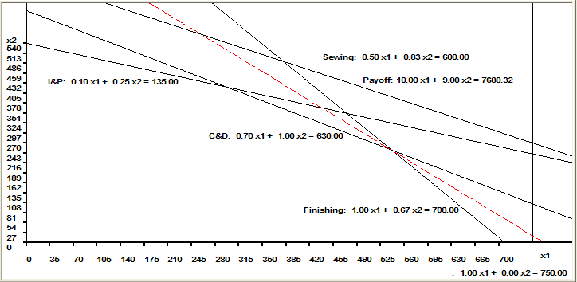
Special Cases of LP Solution: Inconsistent Problem
Par Example:
Assume there is an additional constraint: need to produce at least 725 standard bags,
i.e., x1 ≥ 725
Profit Contribution Maximize 10 x₁ + 9 x₂
ST
Cutting & Dyeing: 7/10 x₁ + x₂ ≤ 630
Sewing 1/2 x₁ + 5/6 x₂ ≤ 600
Finishing x₁ + 2/3 x₂ ≤ 708
Inspection & Packaging 1/10 x₁ + 1/4 x₂ ≤ 135
x₁ ≥ 725
x₁ ≥ 0 , x₂ ≥ 0

Slide 9
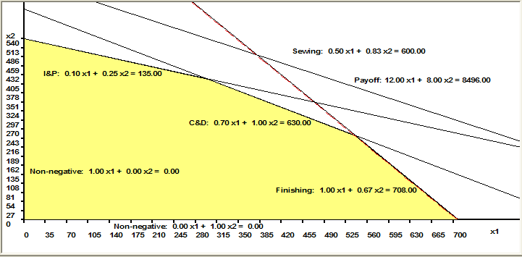
Special Cases of LP Solution: Multiple Optimal Solutions
Par Example:
Assume the profit contribution of the standard bag is $12 and the profit contribution of the deluxe bag is $8.
Profit Contribution Maximize 12 x₁ + 8 x₂
ST
Cutting & Dyeing: 7/10 x₁ + x₂ ≤ 630
Sewing 1/2 x₁ + 5/6 x₂ ≤ 600
Finishing x₁ + 2/3 x₂ ≤ 708
Inspection & Packaging 1/10 x₁ + 1/4 x₂ ≤ 135
Non-negative: x₁ ≥ 0 , x₂ ≥ 0

Slide 10
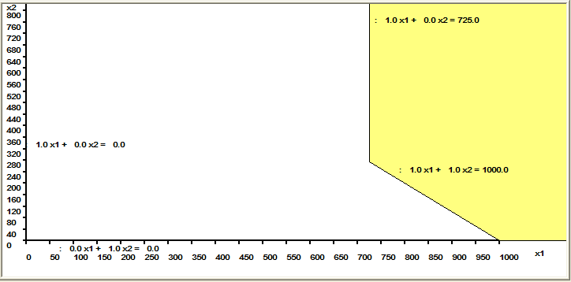
Special Cases of LP Solution: Unbounded Problem
Suppose we have the following problem:
Maximize 10 x₁ + 9 x₂
Such that:
x₁ + x₂ ≥ 1000
x₁ ≥ 725
x₁ ≥ 0 , x₂ ≥ 0

Slide 11
Summary of Special Cases
Special cases | Graphical | Excel Solver Message | Managerial Implication
Inconsistent problem | Feasible region does not exist | “Solver could not find a feasible solution” | Too many restrictions
Multiple optimal solutions | Slope of the objective function is the same as that of one constraint | Give one optimal solution
Unbounded problem | Optimal objective function value is infinite | “The Set Cell values do not converge” | Problem is improperly formulated: too few constraints, wrong objective function

Slide 12
LP Formulation Guidelines
Formulation: also called modeling, the process of translating a verbal statement of a problem into a mathematical statement.
Guidelines for formulation
1. Understand the problem
2. Ask the following three questions:
(i) What must be decided? What are the decision
variables?
(ii) What measure should we use to compare alternative
sets of decisions?
(iii) What restrictions limit our choices?
3. Write the mathematical representation of the objective function in terms of the decision variables
4. Write the constraints in terms of the decision variables
5. Check your formulation!
-Does it make sense?
-Is there any data in the problem you haven’t used?

Slide 13
RV Example
A single plant is used to assemble three RV models: Standard, Fancy, and Luxury. The plant shop capacities (in hours per week) and the times each model spends in a particular shop are given in the table below. The ``contributions” are profit per vehicle manufactured. What product mix maximizes the plant’s profit? Formulate the linear program.
Shop | Capa-city | Standard (mfg time) | Fancy (mfg time) | Luxury (mfg time)
Engine | 120 | 3 | 2 | 1
Body | 80 | 1 | 2 | 3
Standard finishing | 96 | 2
Fancy finishing | 102 |  | 3
Luxury finishing | 40 |  |  | 2
Contribution |  | $840 | $1120 | $1200

Slide 14
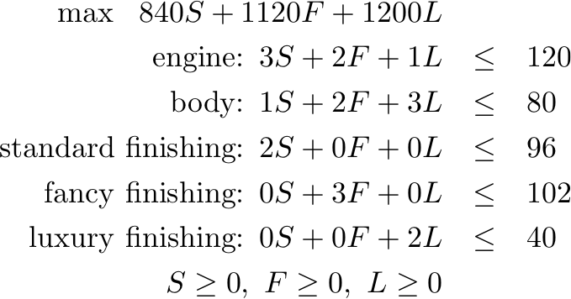
RV Example: LP Formulation
Solving the problem using Excel Solver yields (as in the previous examples):
S=20, F=30, and L=0
The value of the objective function is $50,400.
Therefore, the plant should produce standard (S) and fancy (F) at the rates of 20 and 30 per week respectively. Since 3(20)+2(30)=120 and 20+2(30)=80, this product mix keeps the engine and body shops fully utilized.

Slide 15
RV: Diseconomy of Scale
Suppose the data in the RV example are exactly as before with this exception: Each of the first 12 units of the Standard model vehicle has $840 as its contribution, and any units in excess of 12 have a contribution of $500 each. What product mix maximizes the total contribution?

Slide 16
Analysis
The model has become less profitable so we may anticipate to make fewer of them
However, it is not clear that we make fewer than twelve at $840 apiece
To re-solve this problem, we need to change the previous linear program in three ways. The first change is to introduce two new decision variables
S₁ = the number of Standard model vehicles made per week and sold a contribution of $840 each
S₂ = the number of Standard model vehicles made per week and sold a contribution of $500 each
The second and third change add constraints and change the objective function

Slide 17
Analysis
The additional constraints needed are:
The new objective function is:

Slide 18
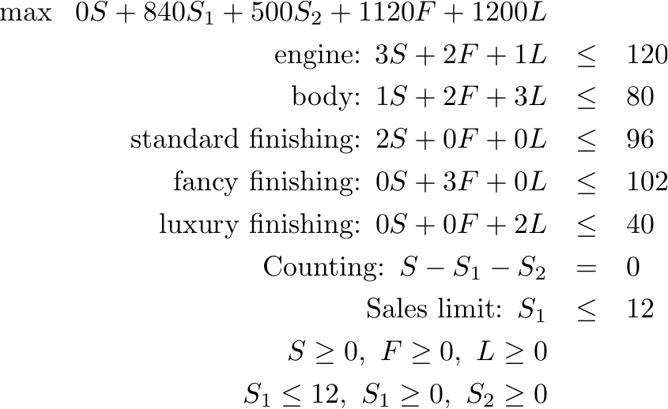
The LP Formulation then is:

Slide 19
Multiple Diseconomies of Scale
The following figure displays a different profit function that exhibits decreasing marginal return.
The analog of the approach we just employed works here as well.
This leads to the following result.

Slide 20
Multiple Diseconomies of Scale
A linear program readily accommodates decreasing marginal return, increasing marginal cost, and other diseconomies of scale.
Summary
Intuition behind the Simplex algorithm
Additional LP formulations
Accommodations of piece-wise linearity

